Slide 1
IS459
Final Project
Group 1
Zuhaili, Darien, Tse Hwee, Jovin, Nicholas, Glenn
Video Link: https://youtu.be/MjCRU8VyMDQ

Slide 2
Table of Contents
Business Problem
Main Audience
Main Objective
Big Data Pipeline Architecture
Tech Stack
1
2
3
4
5

Slide 3
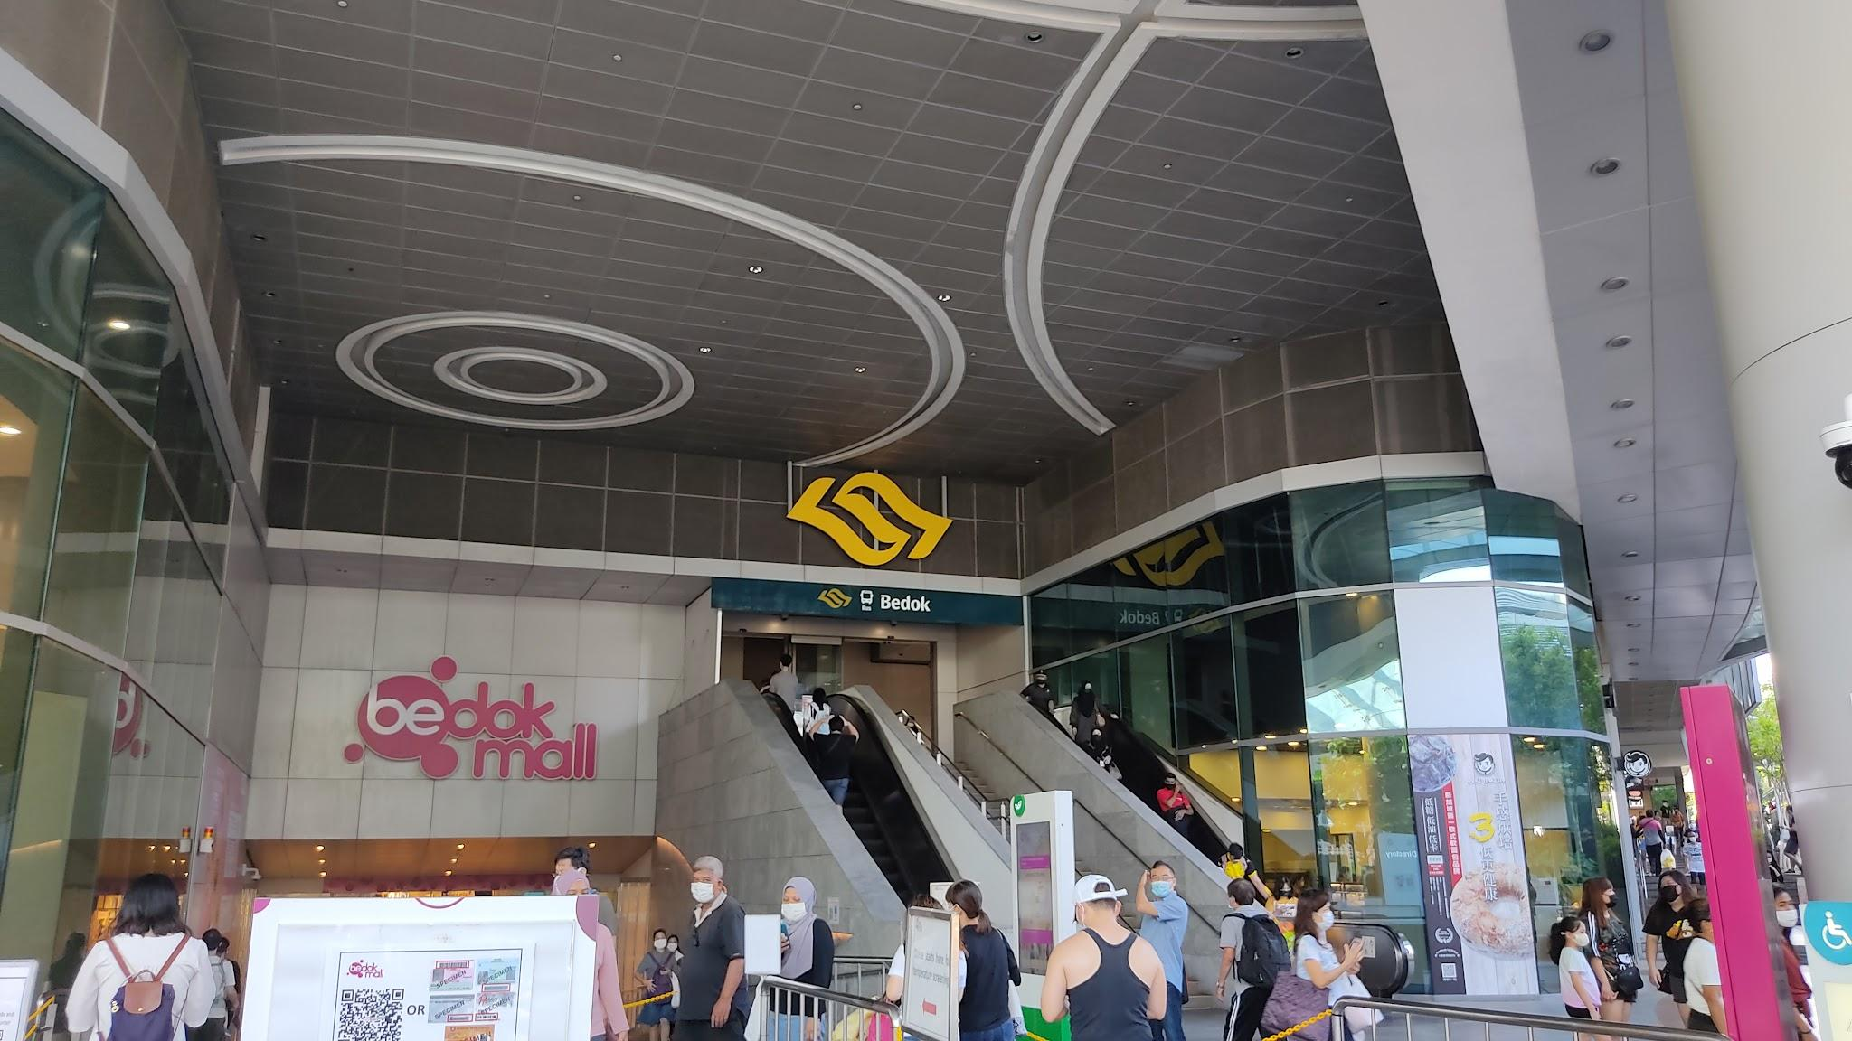
Business Problem
Prospective shop owners in malls often face challenges in selecting the most suitable mall for their stores due to limited visibility into the competitive landscape, complex decision-making processes, and the lack of accessible data and insights.

Slide 4
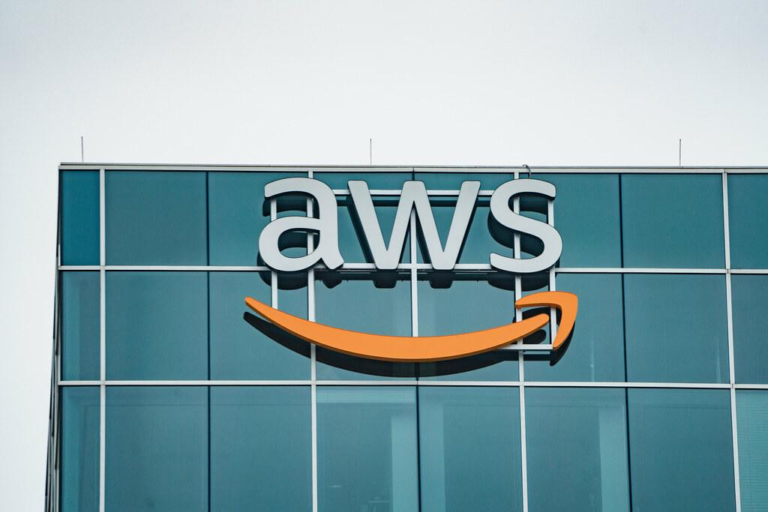
Solution
Our solution aims to optimise store placement with data-driven insights for prospective shop owners in malls.

Slide 5
Main Objective
Implement a data-driven tenant-matching platform to optimise store placement with data-driven insights for prospective shop owners in malls.

Slide 6

Persona Introduction - Darien Ramsay
About Darien:
Aspiring restaurateur with a passion for establishing a restaurant within a mall
Limited experience in the food and beverage industry
Seeking a solution that can guide him in selecting the most suitable location for his store within the mall.
He is looking for:
Insights into the local market
Rental pricing
Competitor analysis
Darien

Slide 7

How Does Our Solution Benefit Darien?
Competitive Edge: Access competitor ratings, aiding differentiation for strategic advantage.
Market Understanding: Provide local demographics and income insights for preferences understanding.
Rental Price Optimization: Offer average rental prices by space for effective allocation.
Darien

Slide 8



Intended Audience & Benefits
Mall owners
Agent
Renters
Sell/rent out the spaces faster, and more efficiently
Eases the burden of finding a suitable tenant
Garner more users, mall owners and renters alike
Obtain the best space for their businesses
Eases the pain of having to find a suitable space

Slide 9
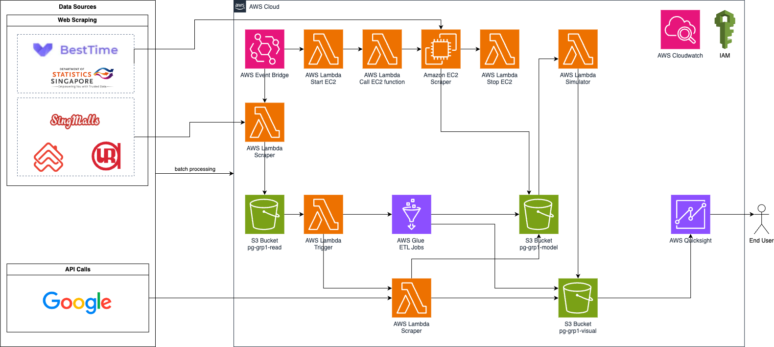
Big Data Pipeline Architecture

Slide 10
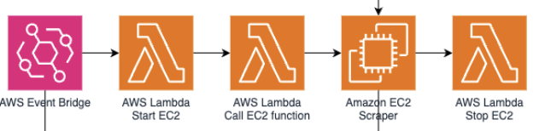

Data Collection
Steps:
Event Bridge to schedule scraping using lambda to S3
For more complex scraping:
Start Ec2 → Scrape → End ec2 → Output to S3
For both footfall and income dataset
2. Move to s3 buckets to be transformed later by glue
Notes:
For singmalls, we use beautiful soup for scraping and it is achievable through lambda shown in the diagram previously.
However for complex scraping and the obtaining of the download file from Singstat, we require the usage of EC2. So the lambda executes the bash script which will run 2 pupeteer scripts

Slide 11
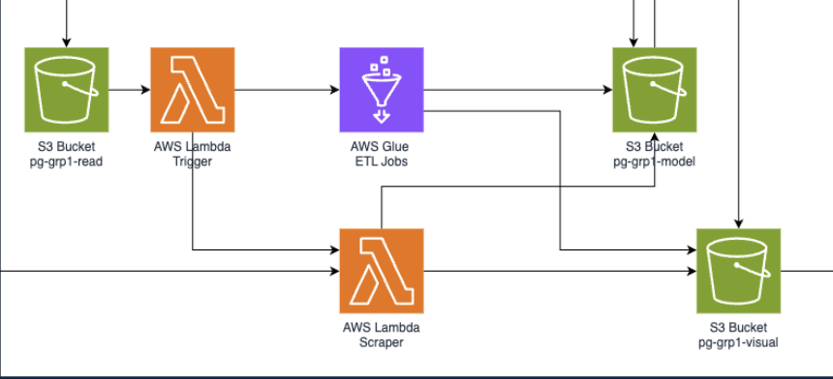
Data Processing
Steps:
Lambda to trigger to read s3 file
Run ETL glue job
External Google API calls
Input final cleaned data into visualization and model buckets

Slide 12

Monte Carlo
Inputs
Footfall
Income of the area
Age demographics of the area
Shops and shop types in the specific mall
Assumptions
Probability of movement within mall
Probability of purchasing by users
Output
Estimated Footfall for each mall (for darien’s shop!)

Slide 13
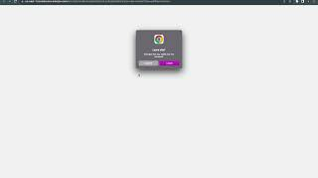
Video Demo
Video Link: https://youtu.be/MjCRU8VyMDQ

Slide 14





Tech Stack: Tools/Packages/Libraries Used
Puppeteer
BeautifulSoup
AWS
Pandas
PySpark
Notes:
For the tools, packages and libraries used, we used puppeteer and beautifulsoup for web scraping. We used AWS for the data pipeline. We used pandas and pyspark for data transformation.

Slide 15
AWS Cost Estimate (Monthly)
Service | Assumptions | Cost (USD)
AWS EventBridge Scheduler | 2 invocations | $0.00 (FREE TIER)
AWS Lambda | <1,000,000 function calls | $0.00 (FREE TIER)
Amazon S3 | 1TB | $23.55
AWS Glue | 10 DPUs, 20 minutes | $1.50
Amazon QuickSight | 1 Author, annual subscription | $18.00
Google Places API | 500 calls | $5
Total: |  | ~$48.05
Notes:
For the estimated monthly costs, we expect to pay around $48.05 on the assumption that EventBridge Scheduler invokes 2 functions, Lambda makes less than 1 million function calls, storage on S3 is 1 terabyte, Glue is running 10 Data Processing Units for 20 minutes, QuickSight has 1 author and on annual subscription and there are 500 calls to Google Places API.

Slide 16

Challenges We Faced
Data Availability and Quality
Integration Complexity
Regulatory Compliance
Complex Data Interpretation
Cost Management
Notes:
Regulatory Compliance: Ensuring that the data collection and analysis processes comply with relevant data protection and privacy regulations can be complex and time-consuming.
Complex Data Interpretation: Interpreting and presenting complex data on demographics, competitor ratings, and rental pricing in a user-friendly format for prospective shop owners may pose a challenge, requiring effective data visualization techniques.
Cost Management: Balancing the costs associated with data acquisition, system development, and ongoing maintenance against the benefits derived by prospective shop owners could be a challenge, requiring effective cost management strategies.
Data Availability and Quality: Obtaining accurate and reliable data on local demographics, competitor ratings, and rental pricing could pose a challenge, potentially impacting the effectiveness of the decision support system.
Integration Complexity: Integrating diverse data sources and ensuring compatibility with the decision support system may present technical complexities and require careful data management strategies.

Slide 17

Future Improvements
More factors and use statistical analysis to determine relationships between factors so that the simulation model will be more accurate
Use sensor data for the model - IoT sensors at malls and nearby areas
Notes:
Moving on to future improvements, we can use more factors and statistical analysis to determine the relationships between factors to make the simulation model more accurate
We can also use sensor data for the model

Slide 18
Thank
You

